Slide 1
Wildfire Planning & Preparedness
San Jose Fire Department
Fire Captain Anthony Ibarra
September 17, 2025

Slide 2
Introduction
Mission Statement
Committed to serving the community by protecting life, property, and the environment through prevention and response.
Community Alliance
Develop and sustain effective relationships with all stakeholders.
Establish outreach efforts to engage and educate the public and stakeholder groups.

Slide 3
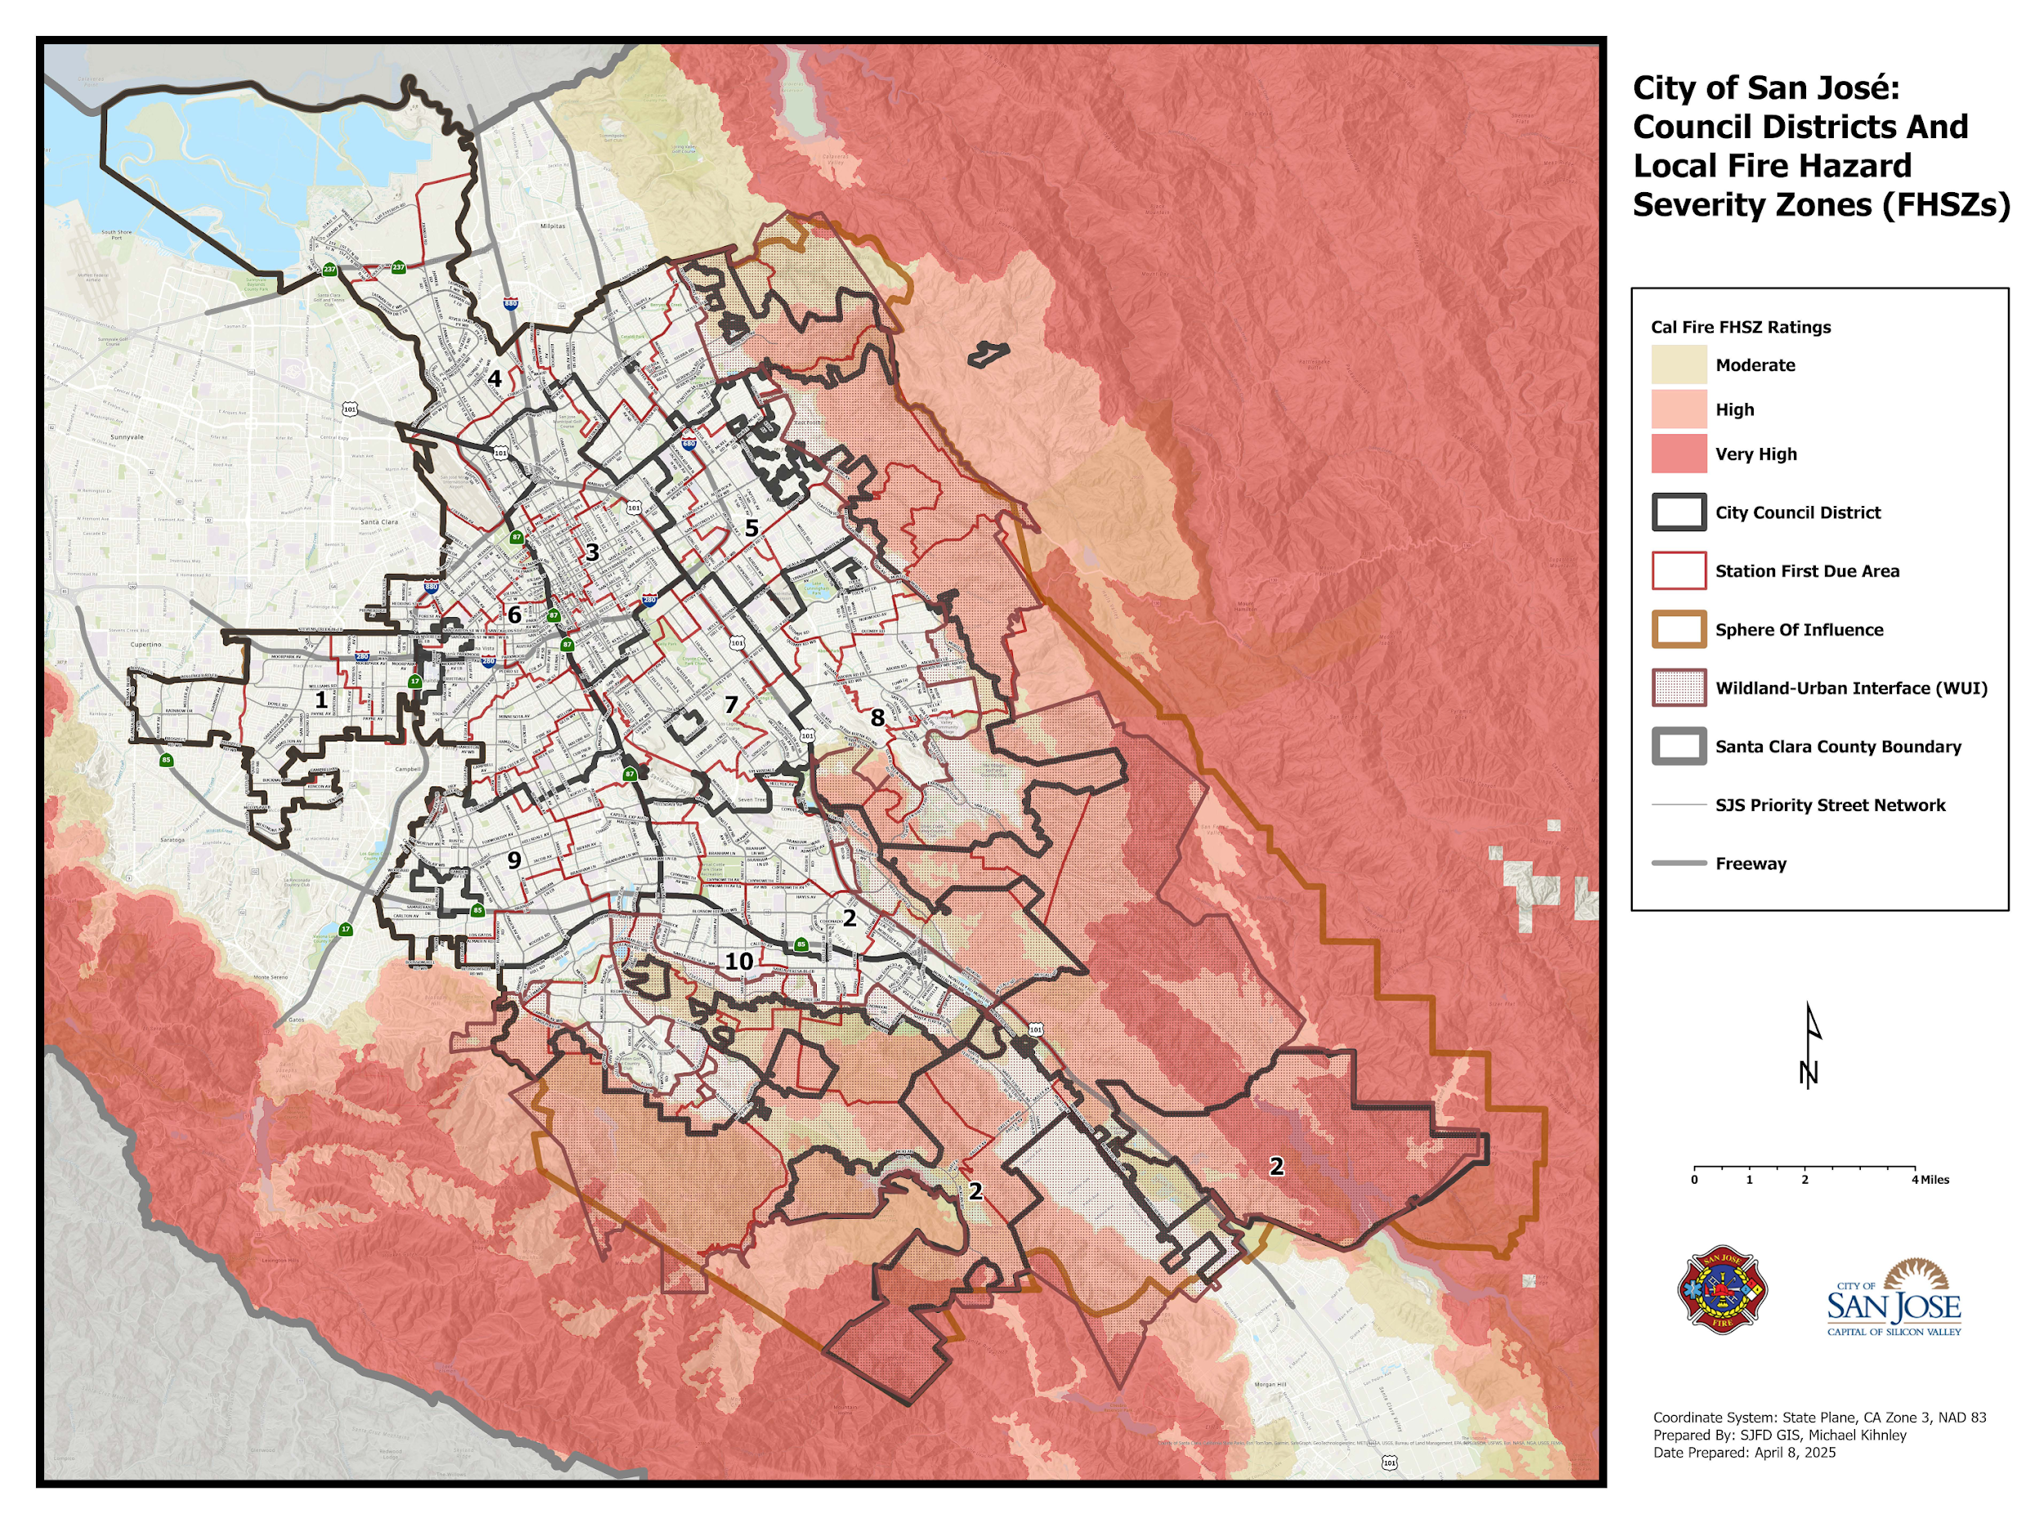
Wildland Areas Within San José

Slide 4
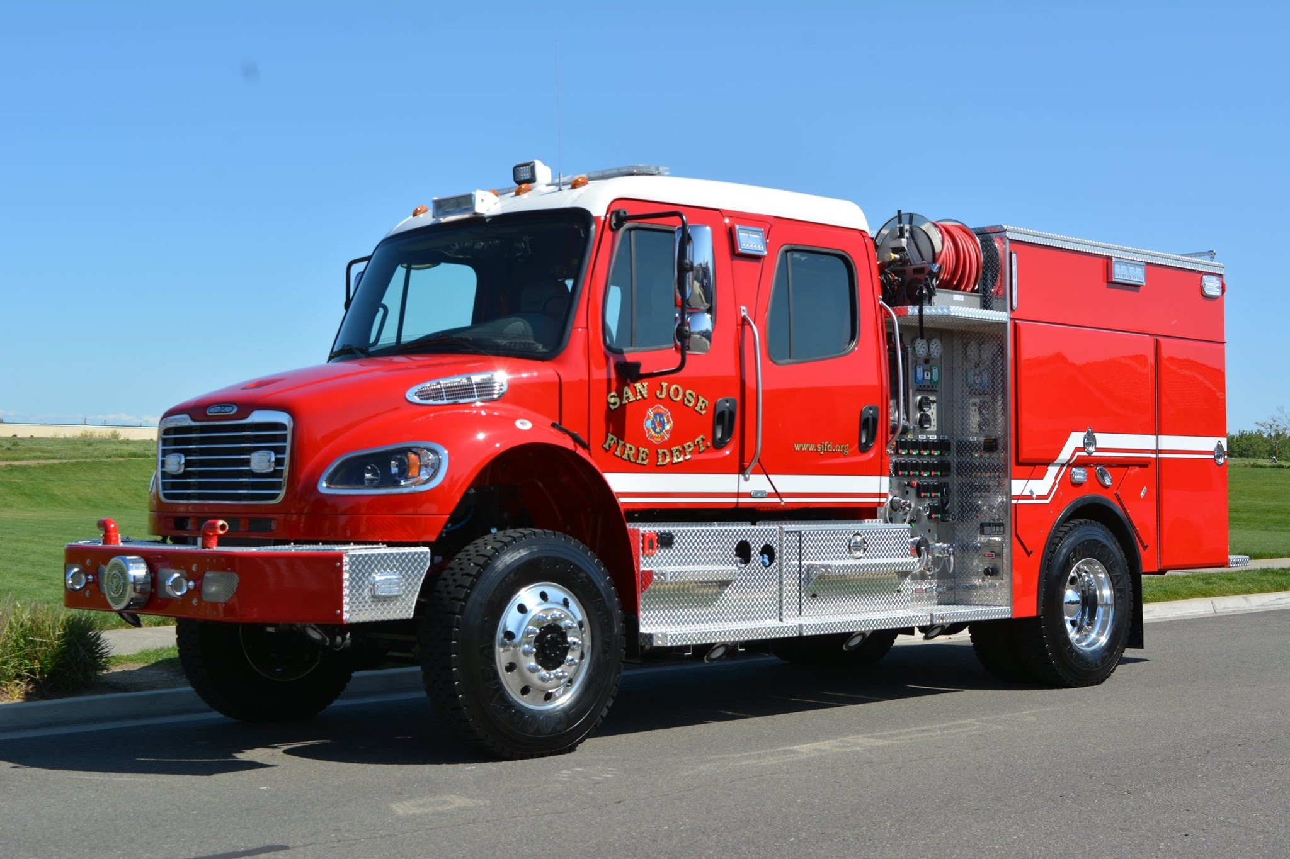
Wildland Firefighter Operations
Firefighting tactics are adapted to ​
work with limited water supply:​
  Response Engines​
  Type 1, 3 & 6 engines carry their own water for ​
  firefighting & have specialized equipment that ​
  allows them to refill from natural or nearby sources ​
  (i.e. pools, creeks, or ponds) ​
  This helps crews stay effective even in areas without fire hydrants​
  ​
  Water Tenders ​
  Transport 2,000 Gallons of water​
  Have the ability to carry portable tanks that can be set up in strategic locations, giving fire engines a place to refill when fighting fires in remote areas

Slide 5
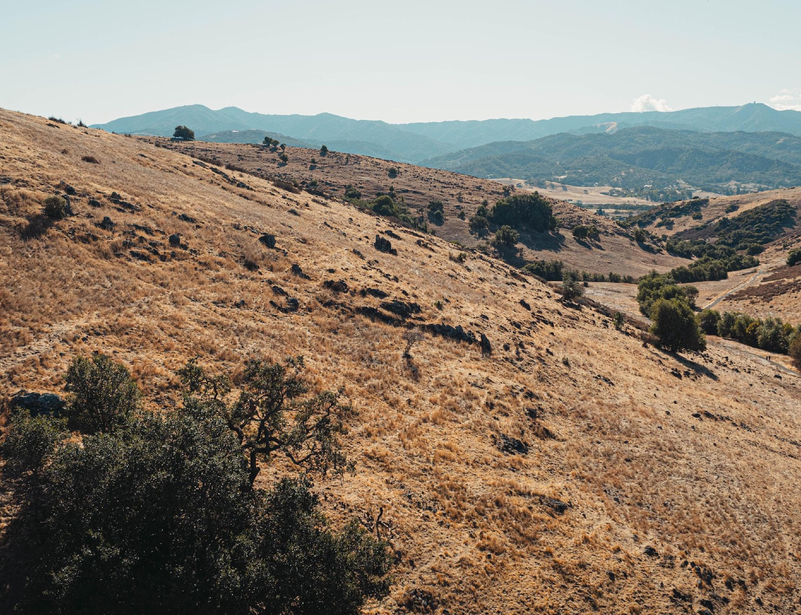
READY
Harden Your Home
Defensible Space ZONES
Smart Landscaping
Wildfire Action Plan | Supply Kits
Family Communication Plan
Insurance Preparedness
SET
GO
Evacuation Readiness
Emergency Evacuation terminology
Staying Informed

Slide 6
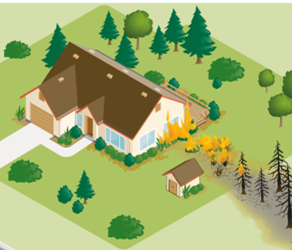
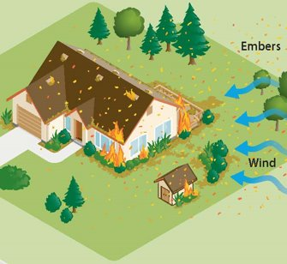
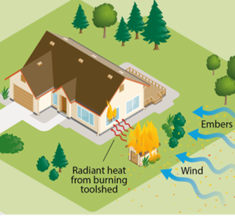
Three Types of Fire Exposure
Direct Flame Contact
Embers
Radiant Heat
Defensible Space strategies have focused on how to reduce direct flame contact.
Preparing for embers and radiant heat exposures takes a different approach.

Slide 7
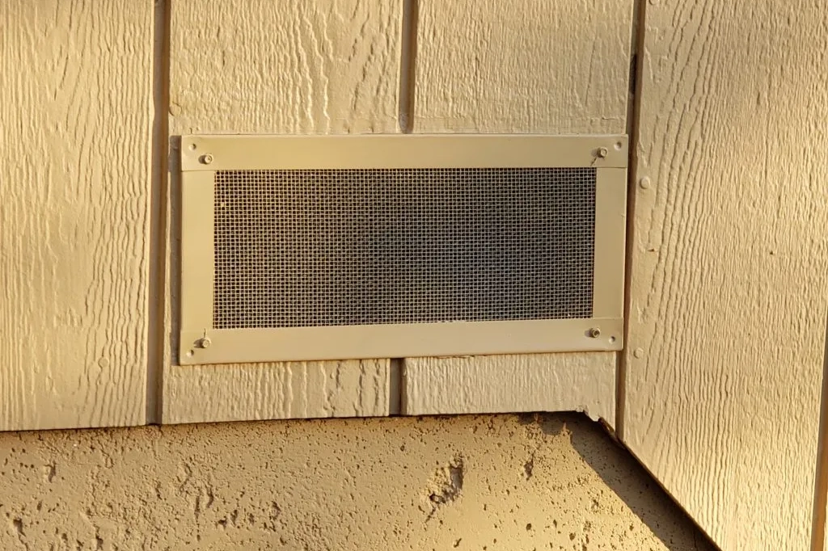
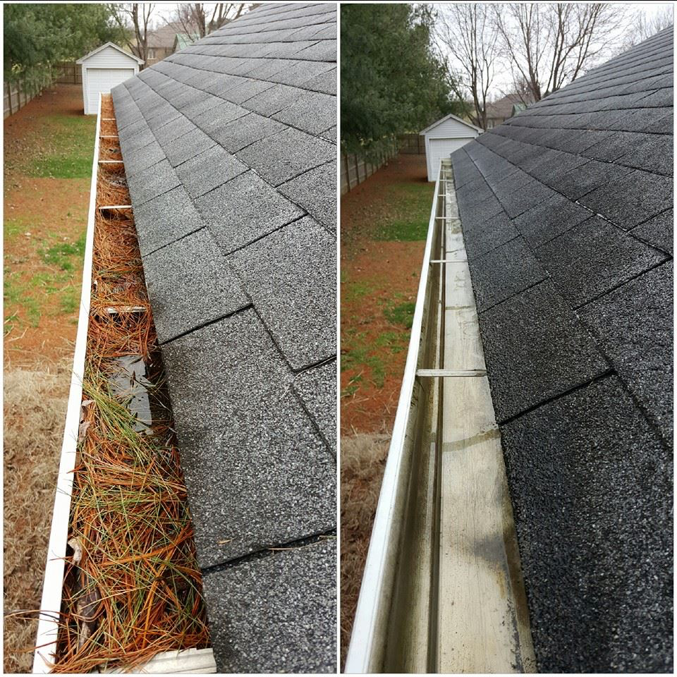

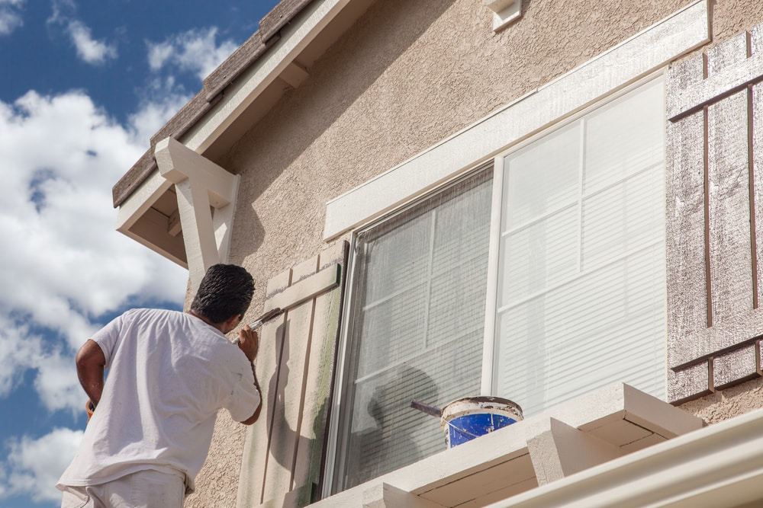
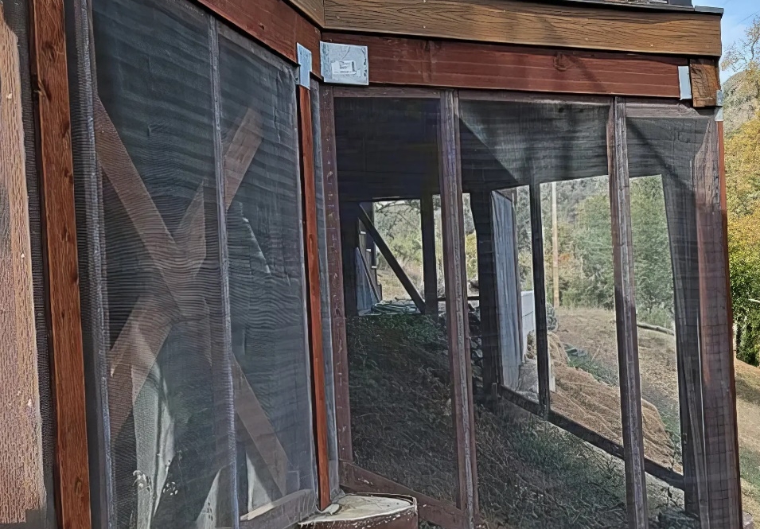
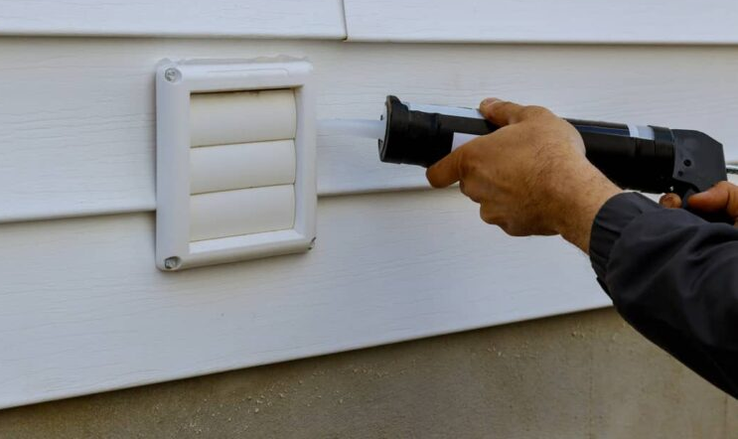



HOME HARDENING
Clear Debris from Gutters & Roof
Maintain Paint on Eaves
& Fascia Boards
Install 1/8” Mesh on Vents
Seal Gaps in Siding, Eaves & Doors
Remove Combustibles
& Enclose Space Under Decks
Install Double Pane Windows
Use Class A Non- Combustible Roofing Materials

Slide 8
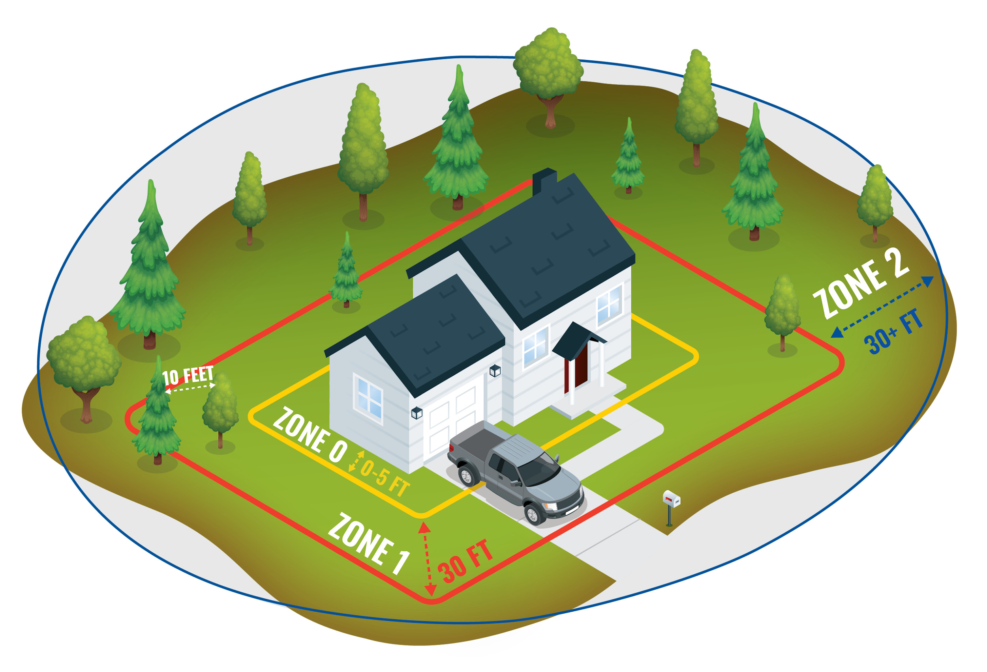
Defensible Space Zones
ZONE 0
0 - 5’
Ember Resistant Zone
ZONE 1
5’ – 30’
Lean, Clean & Green Zone
ZONE 2
30’ – To Property Line
Fuel Reduction Zone

Slide 9
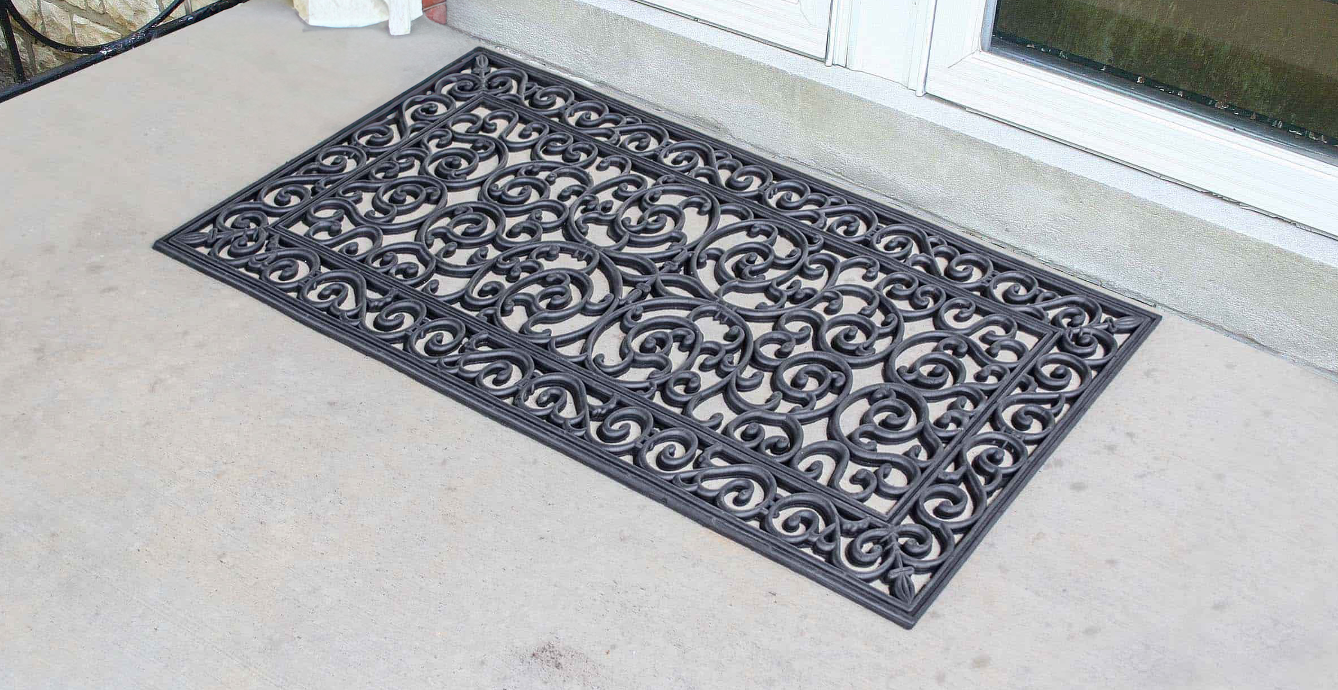
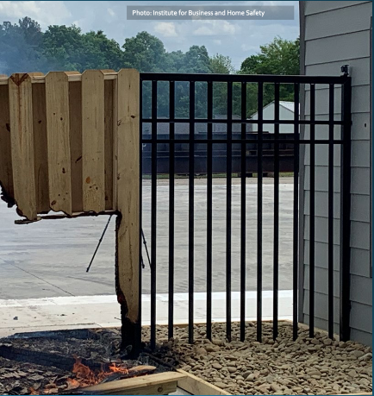
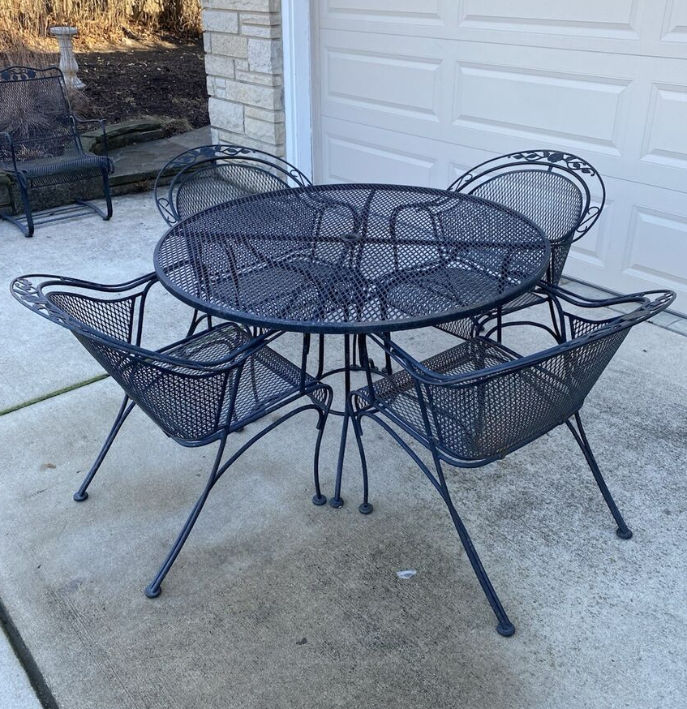
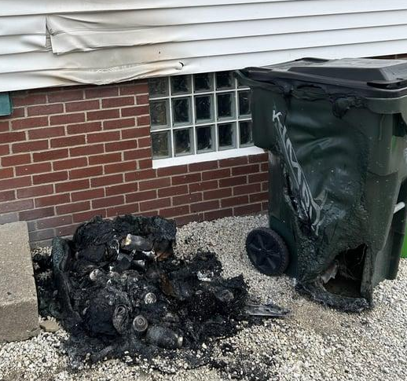
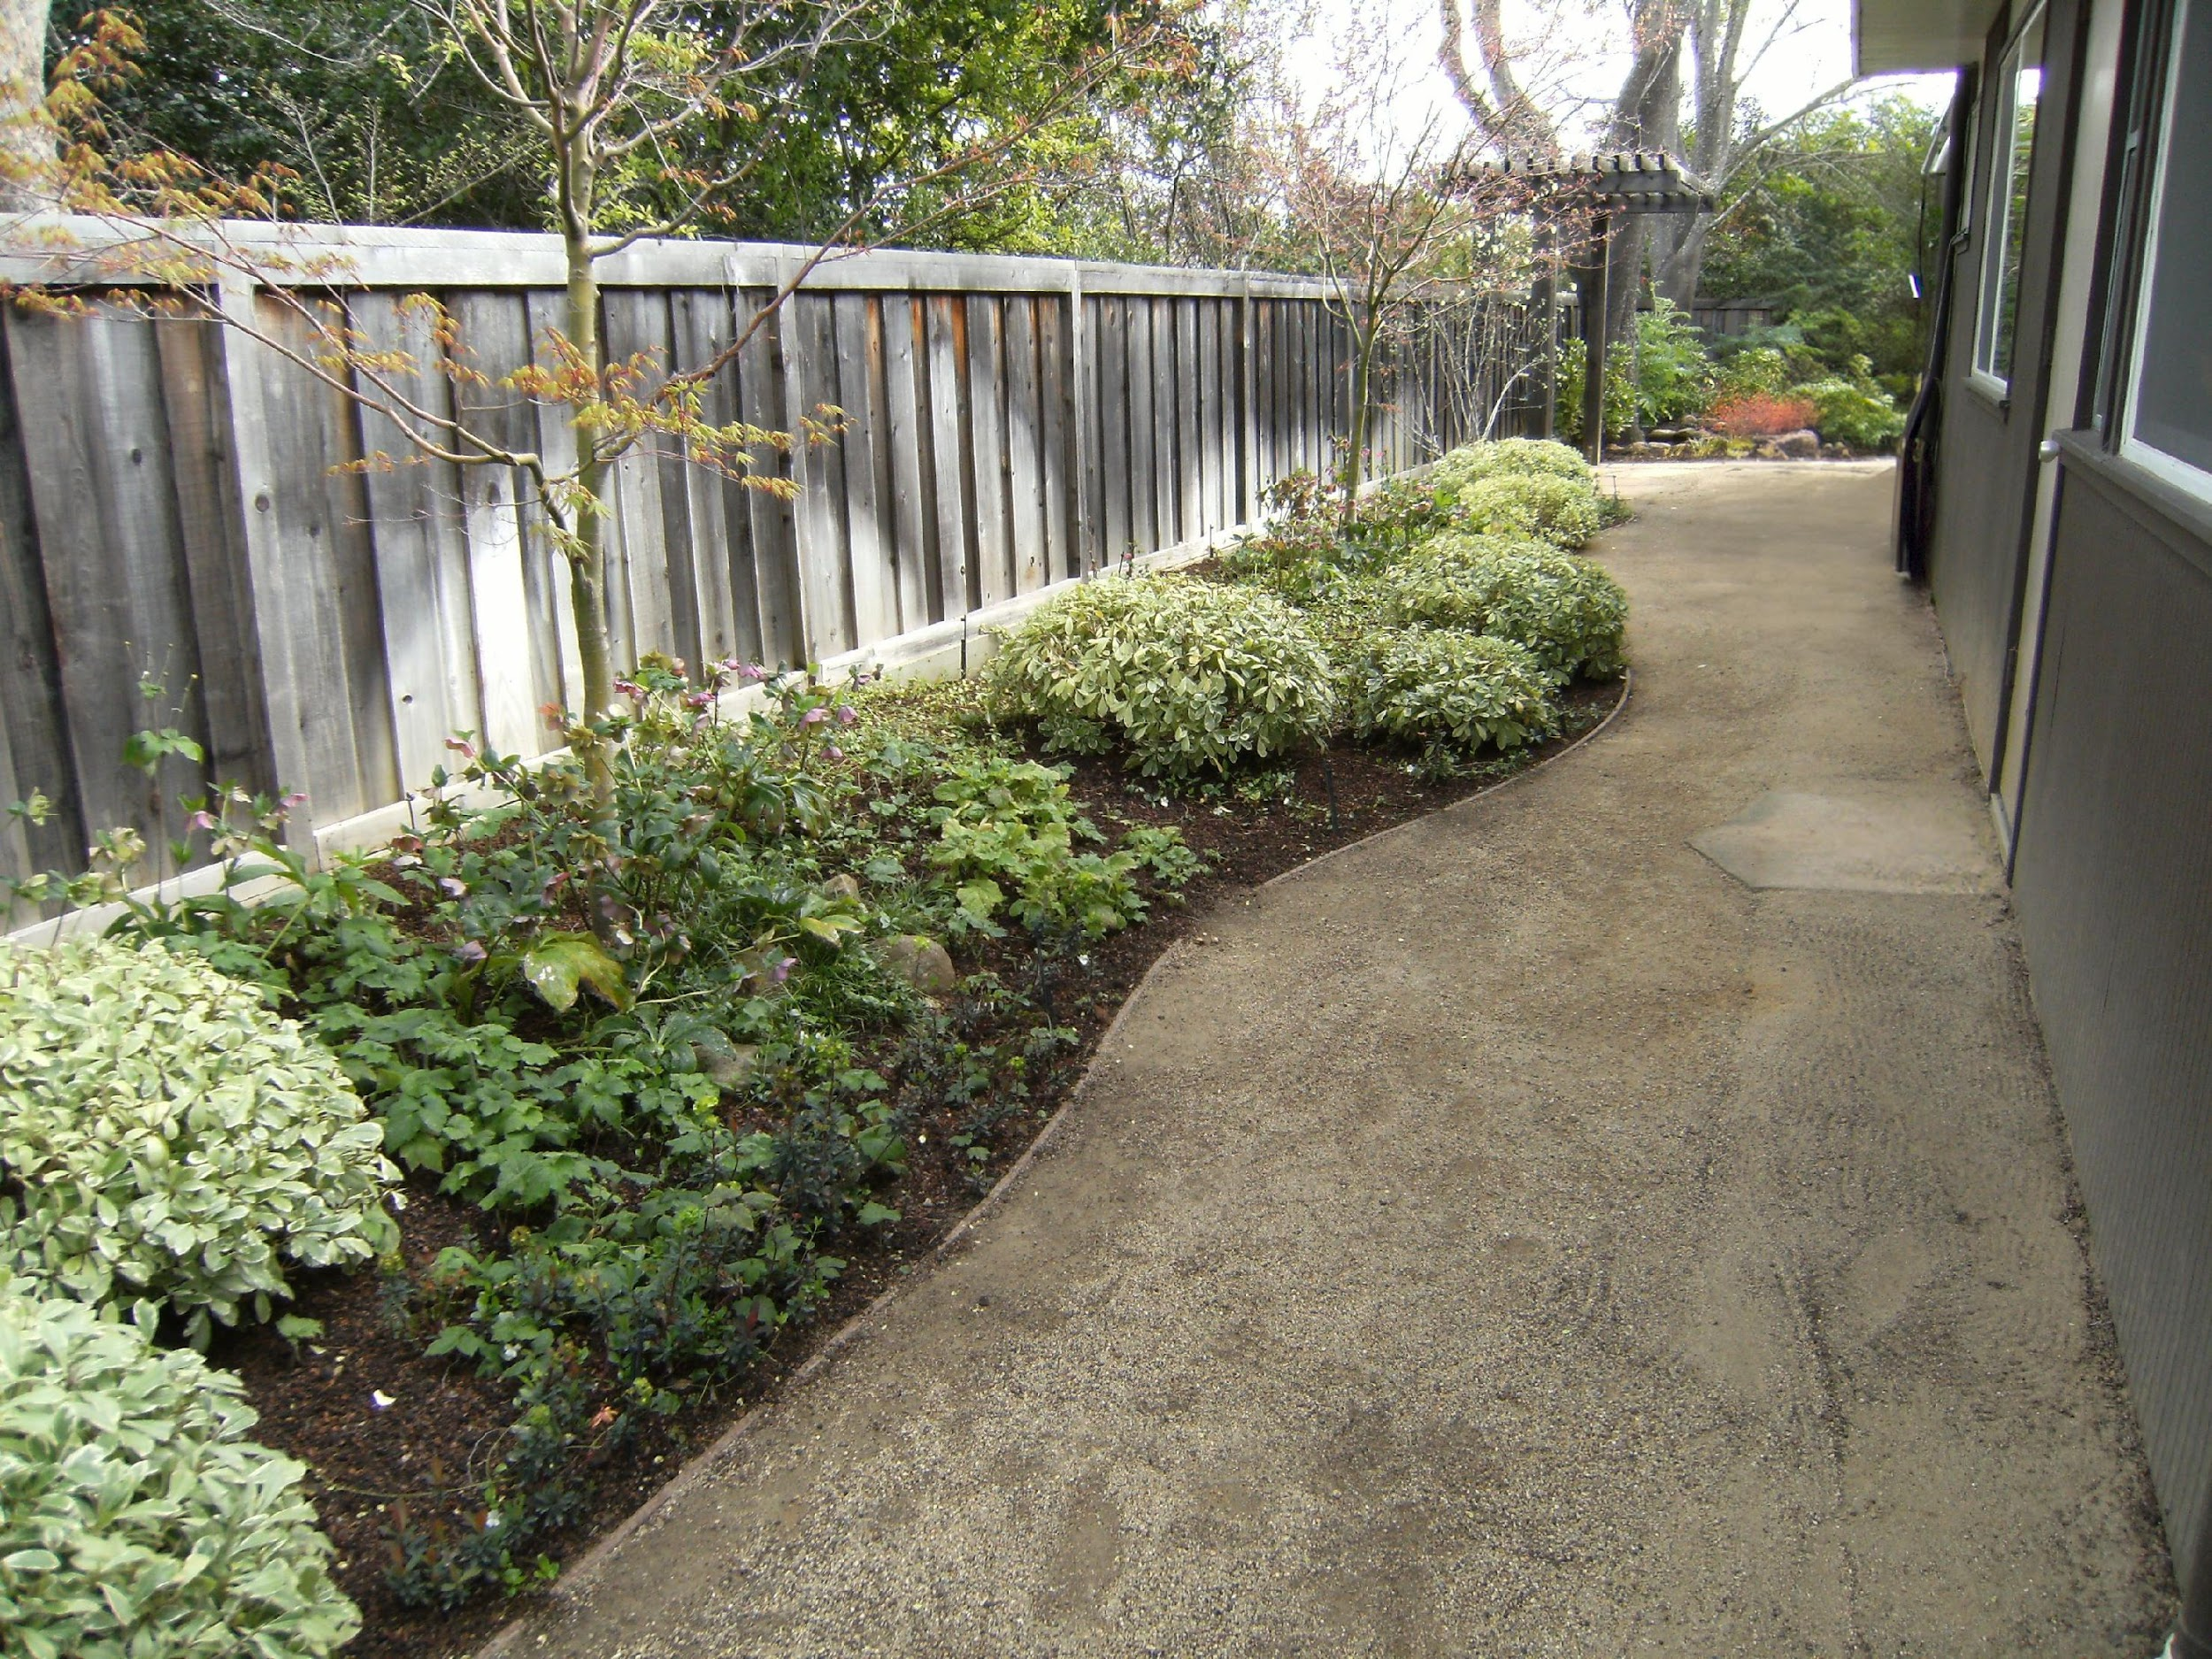
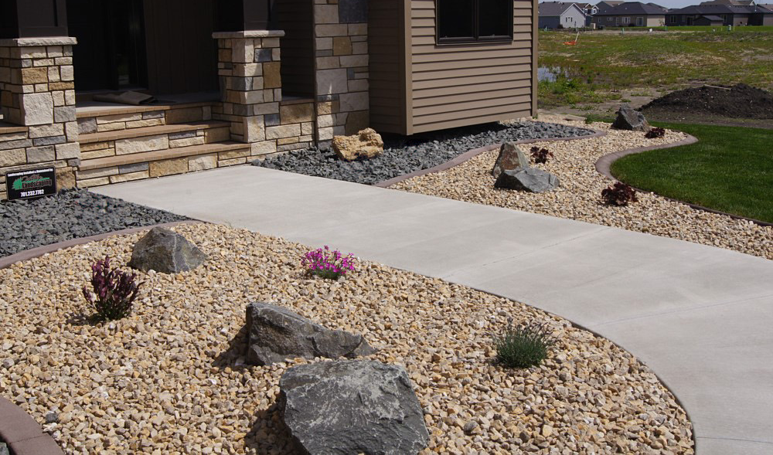
Non-combustible patio furniture
Replace natural fiber doormats with Ignition Resistant Materials
ZONE 0
0 - 5’
Install Metal Gates In The 0-5ft Zone
Relocate Trash Cans
Outside 0-5ft Zone
Hardscape Yards
Remove All Combustible Materials

Slide 10
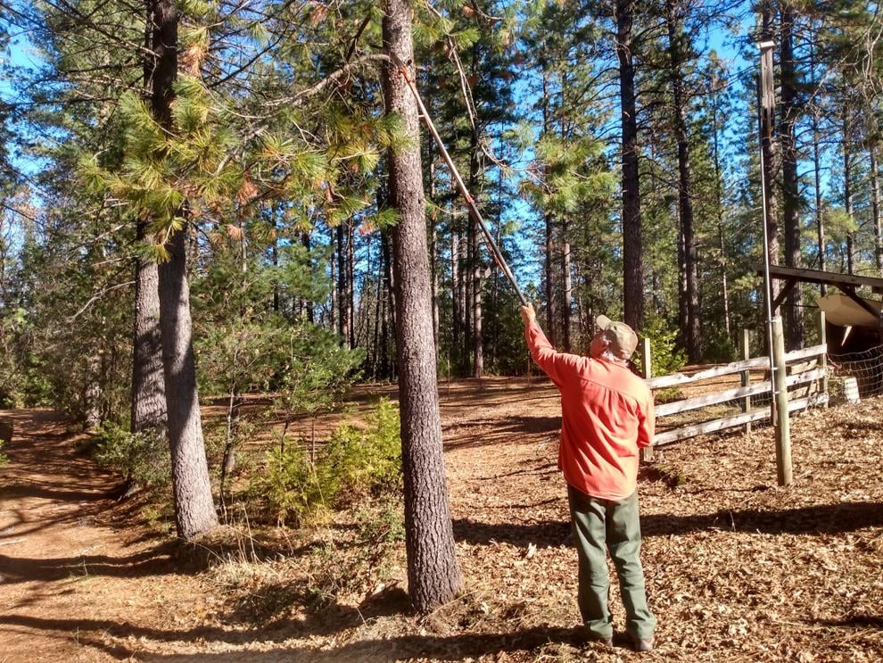
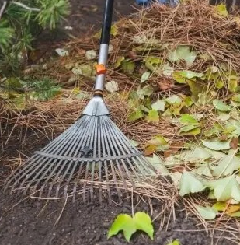

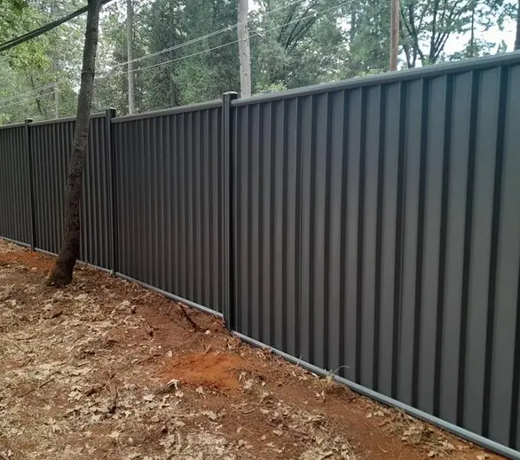
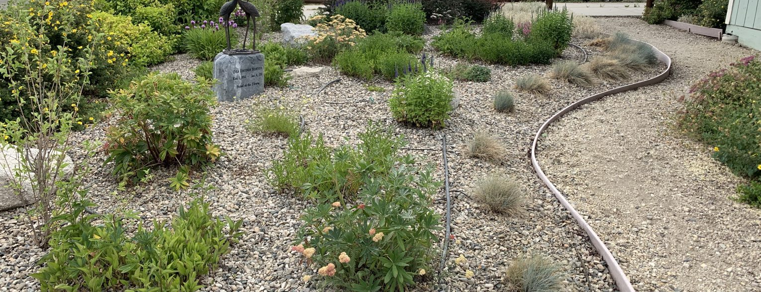
ZONE 1
5’ – 30’
Use Rocks In Place of Mulch
& Properly Space Vegetation
Limb Up Trees 6-10’ From Ground
Remove Dead Leaves & Pine Needles
Choose Fire Resistant & Drought Tolerant Vegetation
Clear Vegetation Around Fences & Structures

Slide 11
ZONE 2
30’ – To Property Line
Reduce Fuel Load

Slide 12
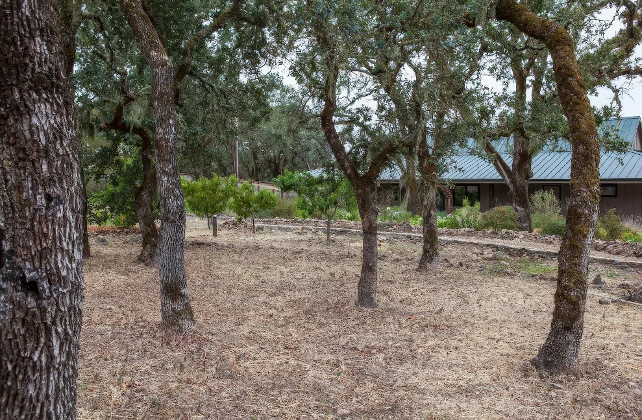
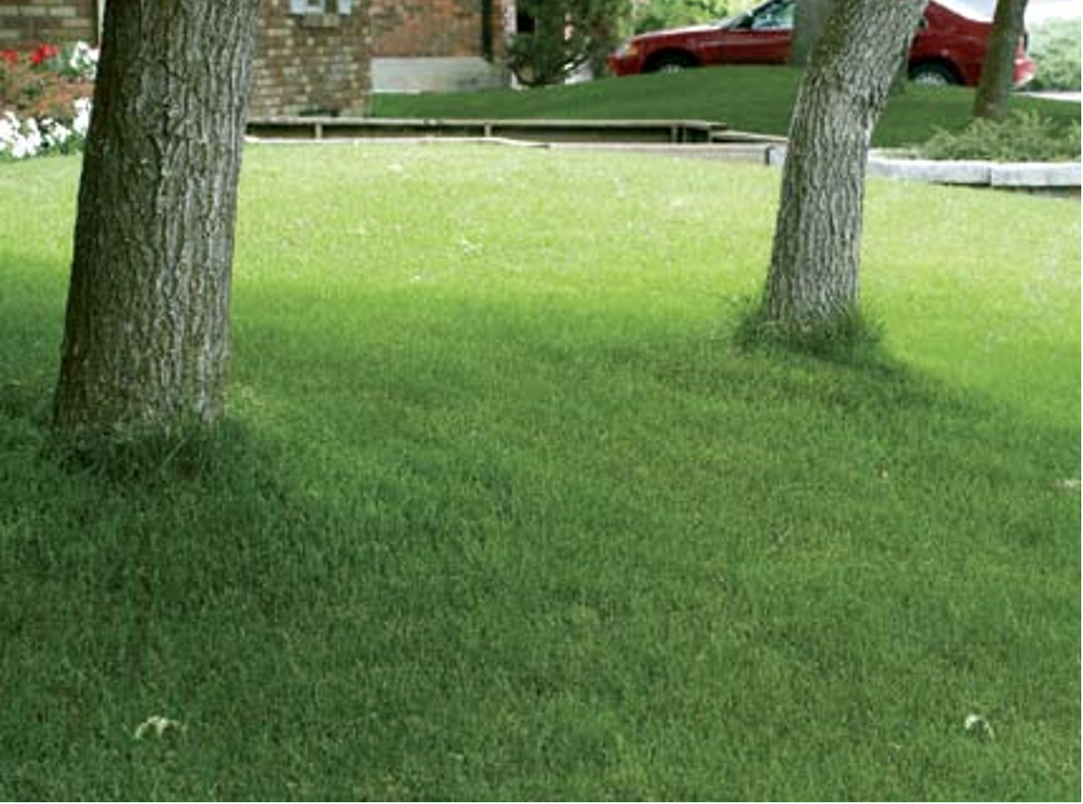
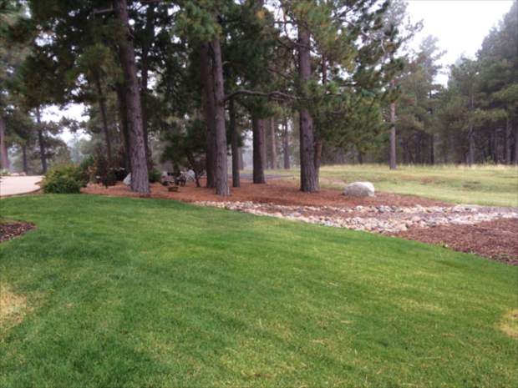
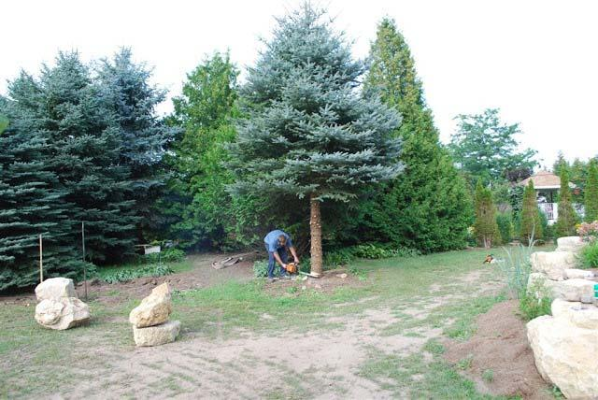
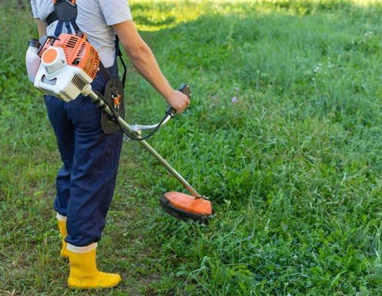
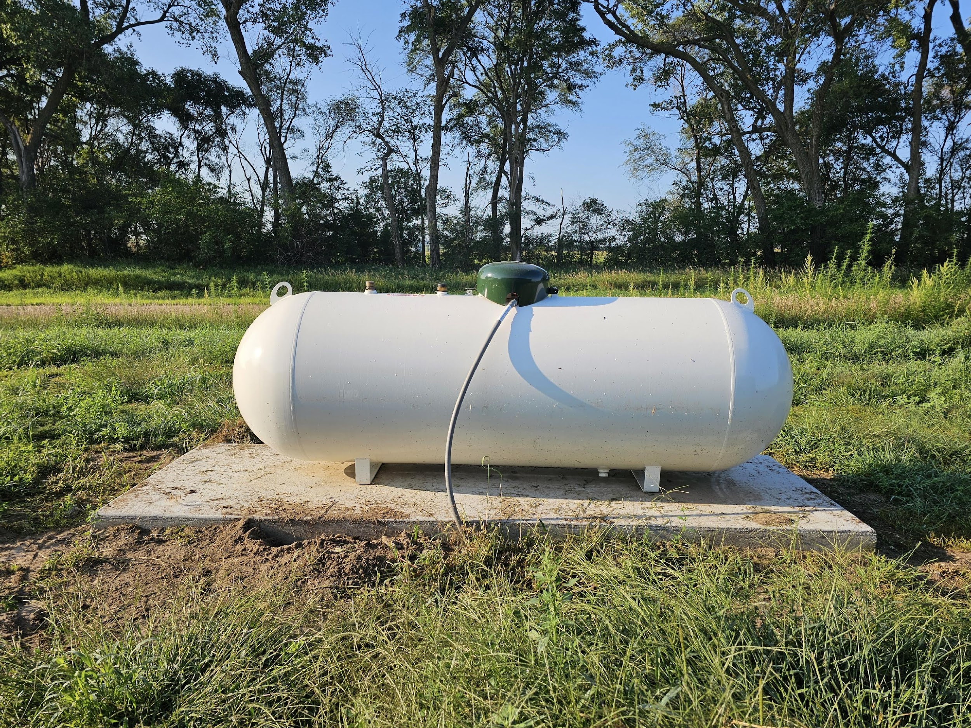
Remove Leaves, Needles & Small Branches
ZONE 2
30’ – 100’ or To Property Line
Create Space Between Trees
Create Vertical Clearance
Cut Annual Grasses
Limb Trees 6+ Feet
Clear Vegetation Around LPG Tanks

Slide 13
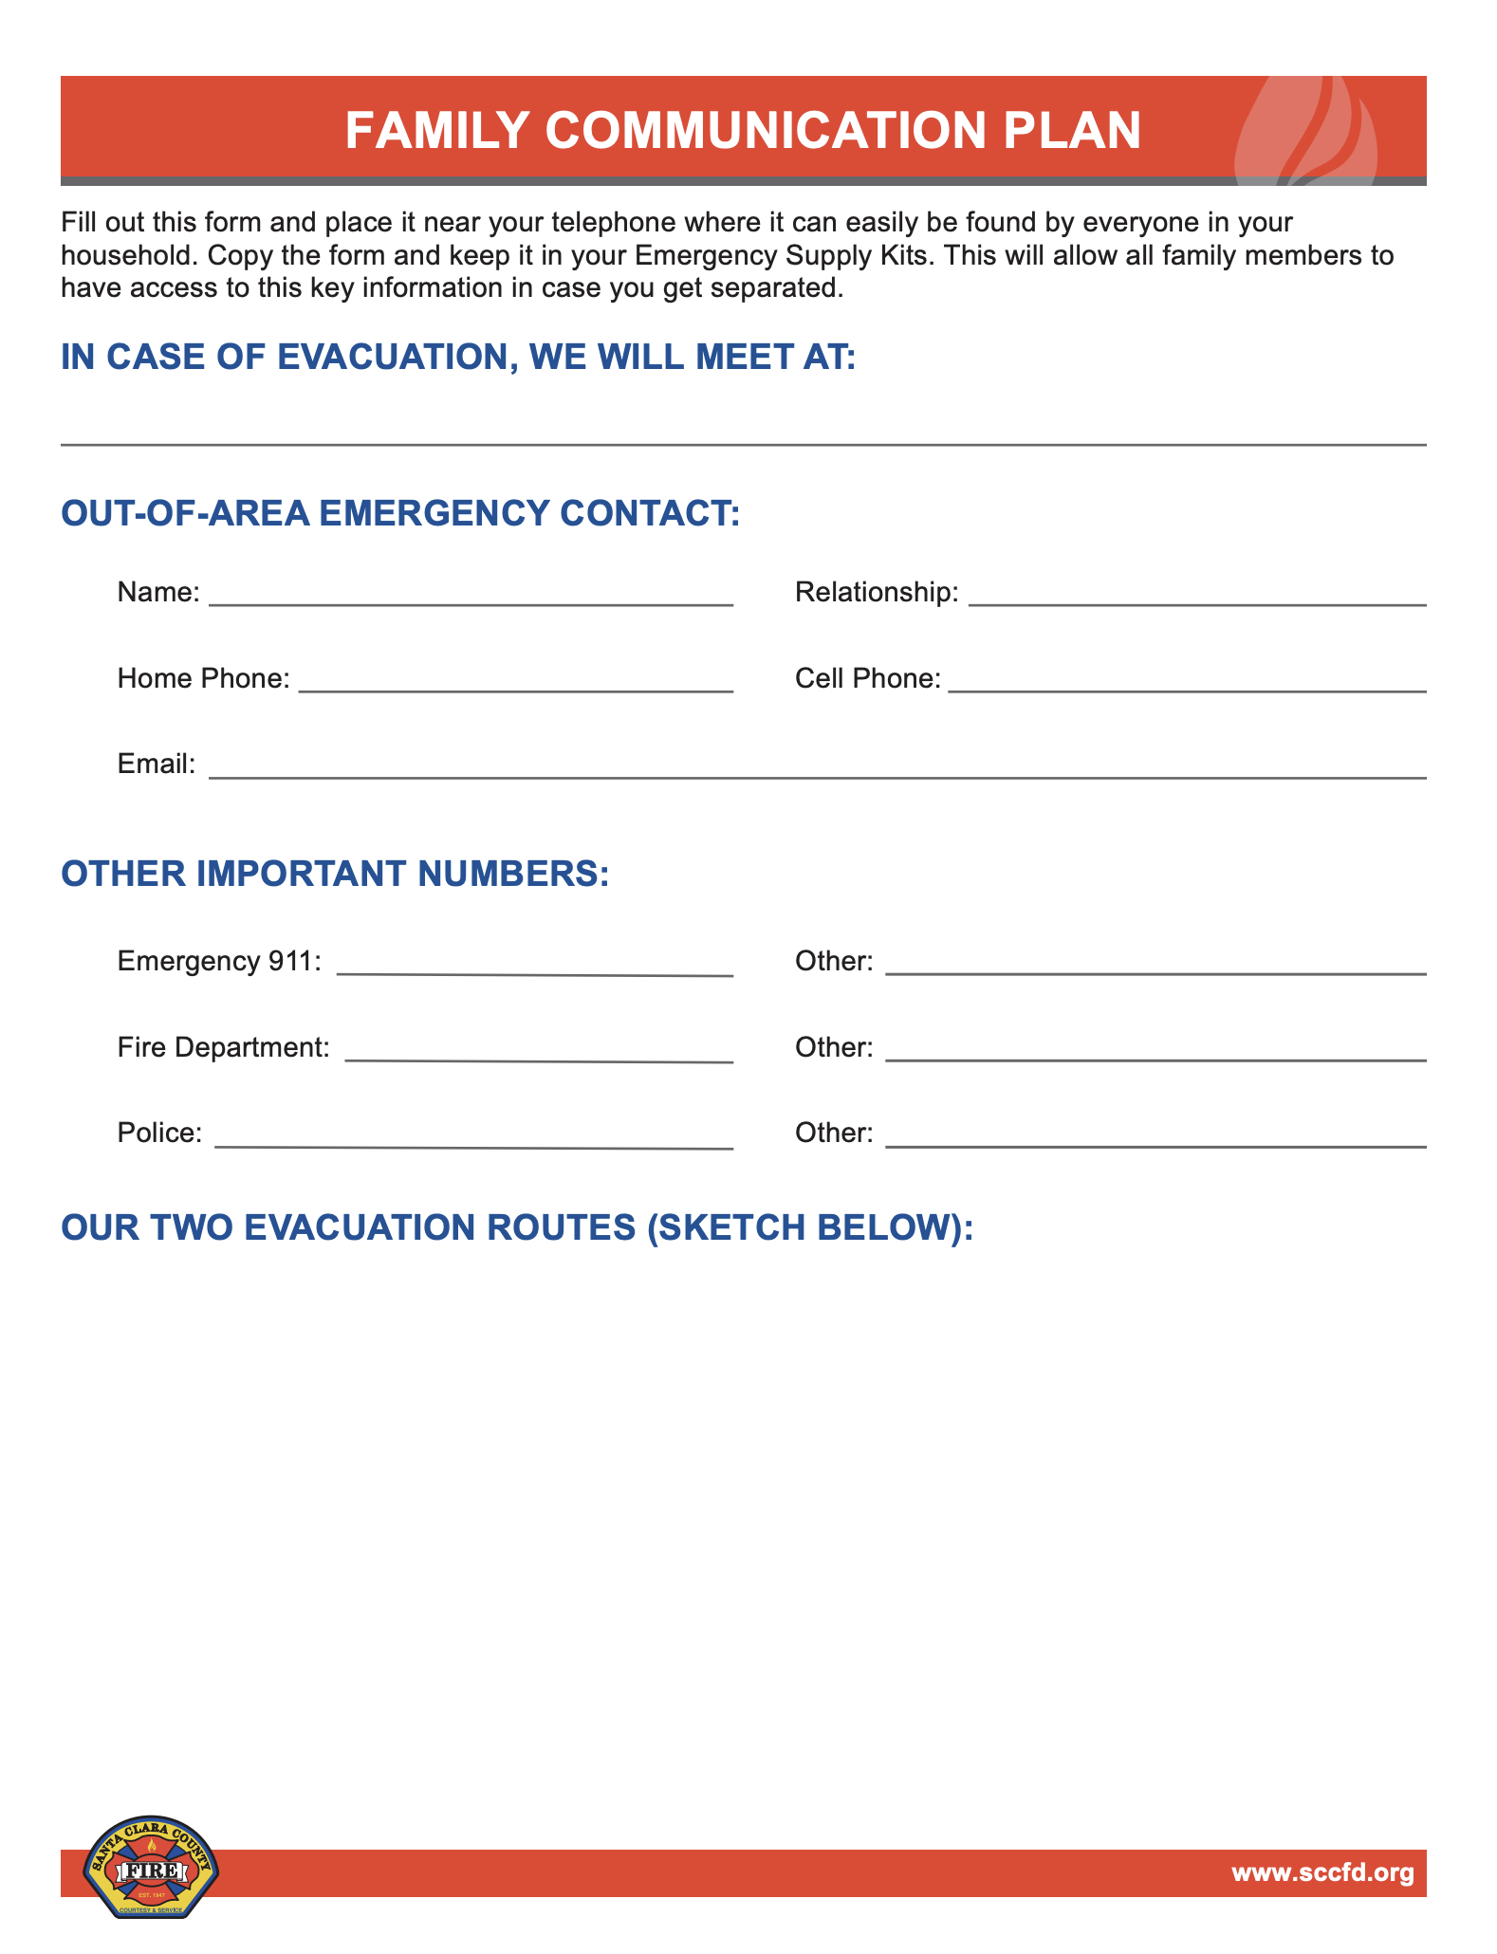

Get
SET
Create A Wildfire Action Plan to Include:
  Develop a Communications Plan
    Create an Emergency Contact List (Family, friends, neighbors)
    Designate an out-of-area contact to act as single point of contact
  Create an Evacuation Plan
    Designate a meeting place outside of fire/hazard zone
    Identify multiple evacuation/escape routes
    Include a plan for pets & large animals
  Remember the SIX P’s
    People/pets
    Papers, phone numbers, and important documents
    Prescriptions, vitamins, eyeglasses
    Pictures & irreplaceable memorabilia
    Personal Computer
    “Plastic” (credit cards, ATM cards) & cash

Slide 14
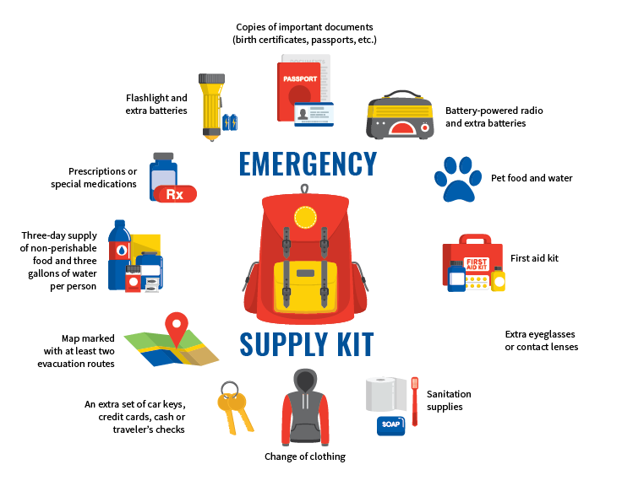
Get
SET
Have an Evacuation ‘Go Bag’ & include essentials:
  Non- Perishable food & water (3-day supply/per person)
  Copies of important documents (birth certificates, passports, etc.)
  Electronic/solar chargers
  Home Inventory (videos/photos)
  Flashlight & batteries
  First aid kit
  Change of clothes
  Sturdy shoes
  Medications & glasses
  Sanitation supplies
  Currency (credit cards, cash, or checks)
  Map
  Pet supplies
If time allows, pack valuables & irreplaceable items

Slide 15

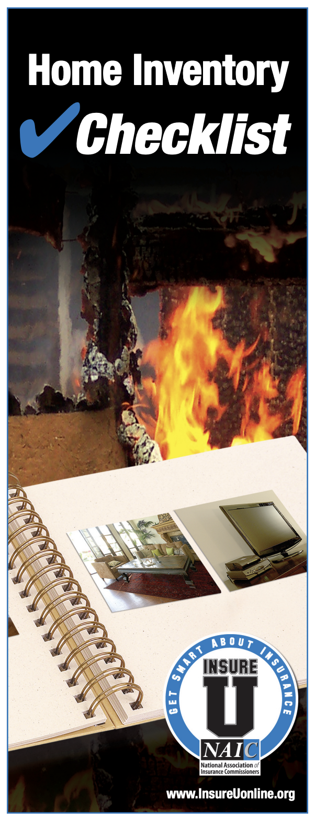
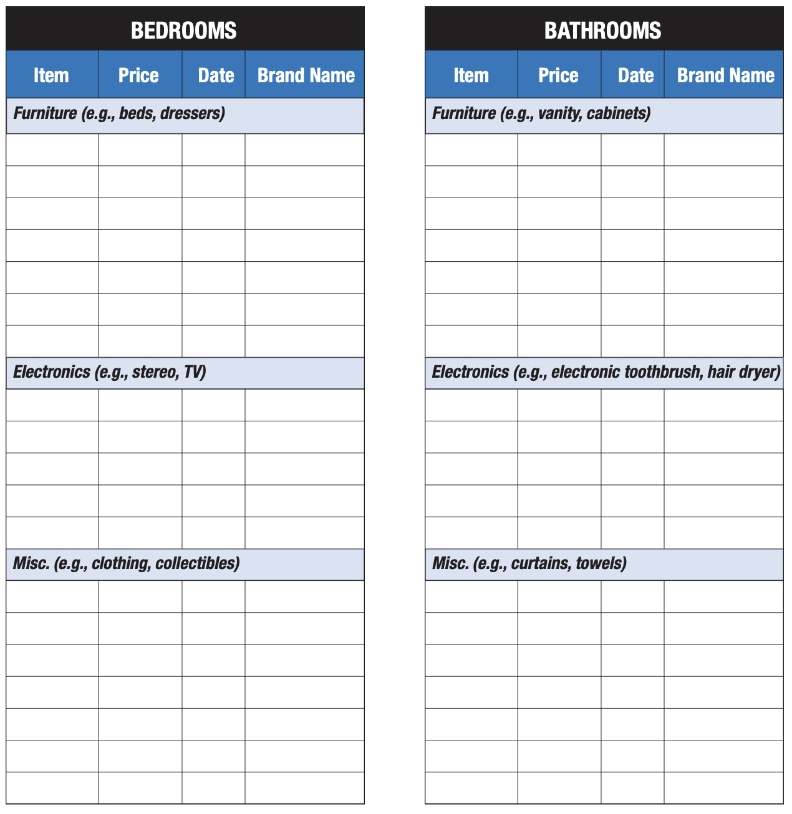

Get
SET
Insurance Preparedness
  Conduct Annual Check Up
    Contact insurance provider annually
    Ensure policy includes key coverages
    (extended replacement costs, inflation adjustments, etc.)
  Have a Home Inventory
    Spreadsheet, photos, and/or videos documenting items in each room
    Note expensive or special items (jewelry, collections, heirlooms, etc.)
    Keep documentation of large purchases/ big ticket items
Loss of Insurance/ Non-Renewal
        Refer to California Department of Insurance for resources

Slide 16
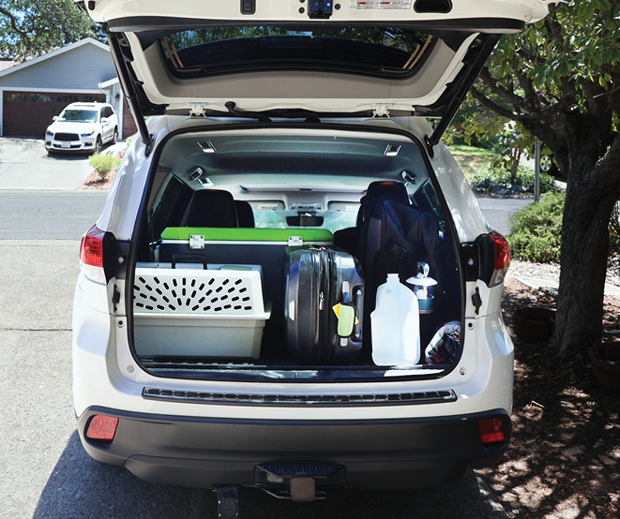
GO!
When Evacuating
  Follow your Wildfire Action Plan
  Put wildfire “Go Bag” & pets into vehicle
  Wear protective clothing & sturdy shoes
  Check on neighbors (if time permits)
  Use pre-determined evacuation routes
Before You Go
  Turn off gas & pilot lights
  Leave lights on & doors unlocked
  Do not shut off water
Stay Informed
  Utilize local news & emergency alert notification systems for evacuation route updates
  Adhere to instructions from local emergency services & authorities
Images courtesy of CAL FIRE

Slide 17







Stay Informed
  Santa Clara County’s official emergency alert system: Provides residents with critical updates on natural disasters, public safety threats & other emergencies
  Residents can sign up for free notifications via text, phone call, or to stay informed about local incidents affecting their area
  Register at: www.alertscc.org
  Know Your Zone: Look up your address online or via the Genasys App
  to find evacuation information for your area
  Access to real-time alerts for disasters, evacuations & other critical situations
  Emergency notifications are sent via text, calls, emails & social media
  Find Your Zone: Protect.genasys.com or Genasys App
    Social Media
Follow credible sources for real time information
(i.e. local Fire Departments, Law Enforcement Agencies, EMS)
@SJFD
@sjfdofficial

Slide 18







Genasys Protect Evacuation Tool
Free and easy to use: Genasys Protect is completely free to download and use—no ads, no subscriptions, and no account needed. Just install it, set your preferred address(es), and enable notifications.
Real‑time, hyper‑localized alerts: Receive evacuation orders, warnings, advisories, shelter-in-place notices, and repopulation updates based only on your location or saved “zones.” You won’t be overwhelmed or bothered by irrelevant alerts.
Interactive evacuation maps and zone tracking: Search addresses, monitor up to five locations (like family homes or schools), and get status updates as conditions change.
Privacy-first design: The app does not track or share your personal identity. Alerts are zone-based and completely anonymous.
Learn more at
protect.genasys.com

Slide 19

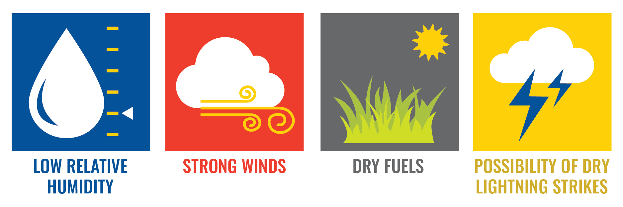
Stay Informed
Red Flag Warning
Indicates critical fire weather conditions, such as strong winds, low humidity, & dry vegetation, increasing the risk of wildfires
Issued by the National Weather Service (NWS), these warnings alert firefighters, emergency responders & the public to take precautions & avoid activities that could spark a fire
During a warning, residents should follow local fire restrictions
& stay updated on emergency alerts.

Slide 20













Connect With Local Agencies Thank you!
American Red Cross
www.redcross.org
408.577.1000
Office of the Sheriff
sheriff.santaclaracounty.gov/home 408.808.4400
California Department of Insurance
www.insurance.ca.gov
800.927.4357
PG&E
www.pge.com
800.743.5000
San José Fire Department
www.sjfd.org
408.794.7000
CAL FIRE
www.fire.ca.gov
Consumer Environmental Protection Agency
https://cepa.santaclaracounty.gov/home
408.918.4600
Santa Clara County FireSafe Council
www.sccfiresafe.org
408.975.9591
Santa Clara County Fire Department
www.sccfd.org/rsg
408.378.4010
Firewise
Community Leaders
www.nfpa.org/education-and-research/wildfire/firewise-usa
Animal Disaster Preparedness & Response
halterproject.org
707.318.7526
Santa Clara County Office of Emergency Mgmt
emergencymanagement.sccgov.org
408.808.7800
MidPen Open Space
www.openspace.org
650.691.1200
Valley Water
www.valleywater.org
408.265.2600

